Slide 1

Ananda Mohan College, Mymensingh
Course: BBA 3rd year
Course name: Management Accounting
Chapter 5: Cost-Volume-Profit (CVP) Analysis
C
V
P

Slide 2

Department of Accounting
Ananda Mohan College, Mymensingh
MUSHFIQUE AHMED
Professor of Accounting
E-mail : musfique64@gmail.com

Slide 3
Learning Objectives
1. Distinguish between variable and ﬁxed costs.
2. Explain the signiﬁcance of the relevant range.
3. Explain the concept of mixed costs.
4. List the components of cost-volume-proﬁt analysis.
5. Indicate what contribution margin is and how it can be expressed.
6. Identify the three ways to determine the break-even point.
7. Deﬁne margin of safety, and give the formulas for computing it.
8. Explain sensibility analysis.
9. Determine sales mix and its effect on break even point.
10. Explain effect of operating leverage on BEP

Slide 4
The content and organization of the chapter
Cost–volume–Profit relationships (CVP)
Part 1
Part 2
Part 3
Cost behavior Analysis
CVP Analysis :1
CVP Analysis: 2
Variable cost
Fixed cost
Mixed cost
Relevant range
Identifying variable, ﬁxed and mixed cost
Segregation of mixed cost
Components of CVP
Break-even analysis
Profit planning
Margin of safety
Income tax and BEP
Sensitivity analysis
Sales Mix and BEP
Operating leverage

Slide 5
Cost Behavior Analysis
Cost behavior analysis is the study of how speciﬁc costs respond to changes in the level of business activity.
Part 1
Variable cost
Fixed cost
Mixed cost
Relevant range
Identifying variable, ﬁxed and mixed cost
Segregation of mixed cost

Slide 6
Cost Behavior Analysis
Part 1
Variable
Fixed
Mixed

Slide 7


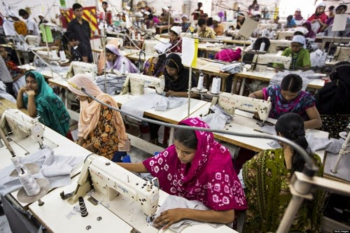
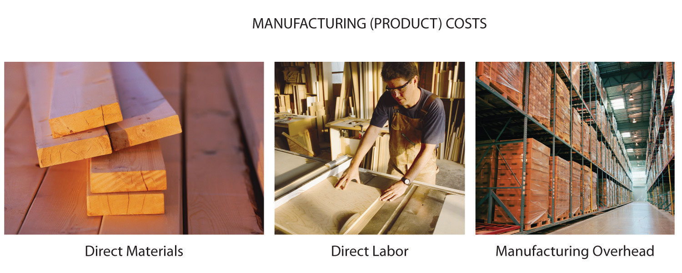

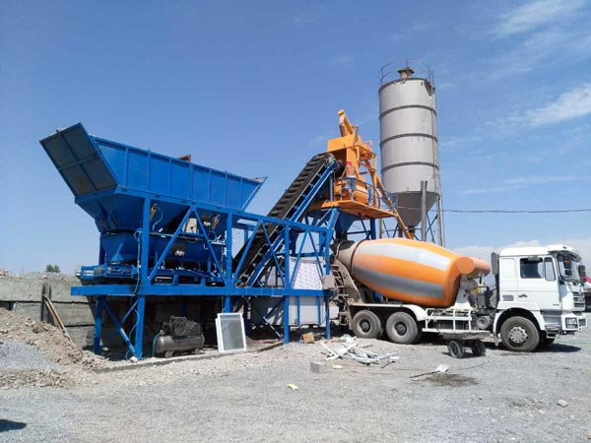


Cost Behavior Analysis
Part 1

Slide 8
Variable Cost
Part 1
  Total variable costs change directly and proportionately with changes in the activity level.
Variable costs per unit do not change as activity
increases.
Examples of variable costs include direct materials and direct labor for a manufacturer; cost of goods sold, sales commissions, and freight-out for a merchandiser.

Slide 9
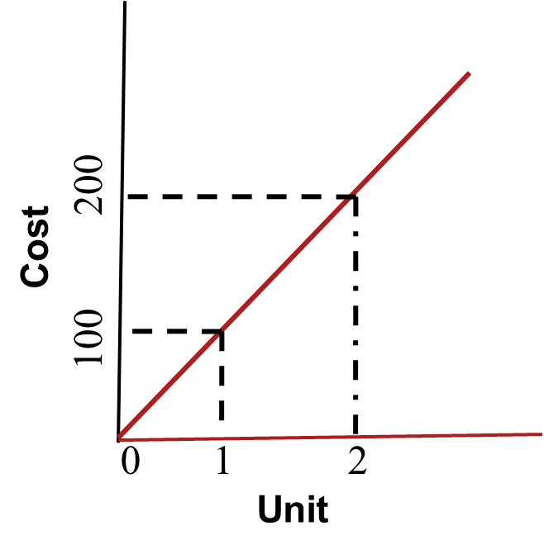
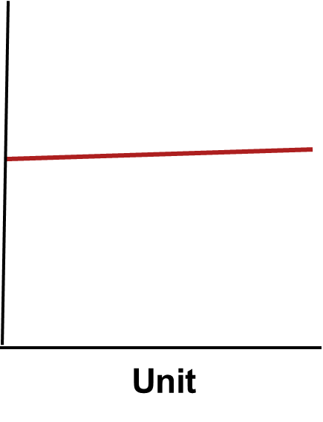
Variable Cost
Part 1
Total Variable costs
Variable costs per unit
Per unit cost

Slide 10
Fixed Cost
Part 1
A fixed cost is fixed only within a given relevant range and a given time span
Total fixed costs remain unchanged when activity changes.
ﬁxed costs per unit vary inversely with activity. As volume increases, unit cost declines, and vice versa.
  Example:
  Fixed Factory overhead
  Office Salary
  Office rent
  Depreciation

Slide 11
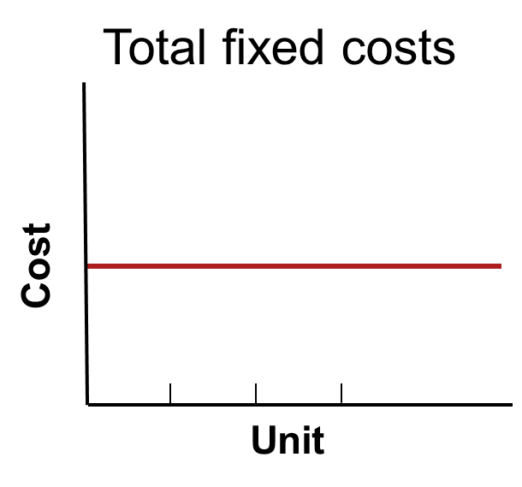
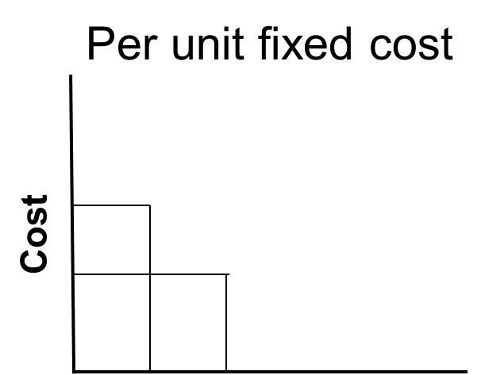
Fixed Cost
Part 1
Unit

Slide 12
Behavior of Variable and Fixed cost
Part 1
 | Behavior of cost within relevant range
Cost | Total amount | Per unit
Variable | Increases and decreases proportionately with activity level | Remains the same regardless of activity level
Fixed | Remains the same regardless of activity level | Increases and decreases inversely with activity level

Slide 13
Relevant Range...
Part 1
Relevant range is the range of activity in which a specific relationship (linear) exists between cost and volume.
Outside of the relevant range, a fixed cost may no longer be strictly fixed or a variable cost may not be strictly variable.
A fixed cost is fixed only within a given relevant range and a given time span.

Slide 14
Relevant Range of fixed cost
Part 1
160,000 –
120,000 –
80,000 –
40,000
–
–
–
Fixed Costs
0 5,000 10,000 15,000 20,000 25,000
Volume in Units

Slide 15
Mixed Costs
Part 1
Mixed costs are costs that contain both a variable element and a ﬁxed element. Mixed costs, therefore, change in total but not proportionately with changes in the activity level.
Example: monthly electric utility charge
  Fixed service fee
  Variable charge per kilowatt hour used

Slide 16
Mixed Costs
Part 1
Total mixed cost
Variable
Utility Charge
Total Utility Cost
Fixed Monthly
Utility Charge
Activity (Kilowatt Hours)

Slide 17
Part 1
Identifying Variable and Fixed Costs
Do it
Monthly production costs in apex Company for two levels of production are as follows.
Cost 2,000 Units 4,000 Units
Indirect labor 10,000 20,000
Supervisory salaries 5,000 5,000
Maintenance 4,000 7,000
Indicate which costs are variable, ﬁxed, and mixed, and give the reason for each answer.

Slide 18
Part 1
Importance of Identifying
Variable and Fixed Costs
If Bangladesh Biman Airlines is to make a proﬁt when it reduces all domestic fares by 30%, what reduction in costs or increase in passengers will be required?
Answer: To make a proﬁt when it cuts domestic fares by 30%, Bangladesh Biman Airlines will have to increase the number of passengers or cut its variable costs for those ﬂights. Its ﬁxed costs will not change.

Slide 19
Importance of Identifying
Variable and Fixed Costs
Part 1
2. If Progati Motor Company meets workers’ demands for higher wages, what increase in sales revenue will be needed to maintain current proﬁt levels?
Answer: Higher wages at Progati Motor Company will increase the variable costs of manufacturing automobiles. To maintain present proﬁt levels, Progati will have to cut other variable costs or increase the price of its automobiles.

Slide 20
Part 1
Importance of Identifying
Variable and Fixed Costs
3. If Bangladesh Steel Corp.’s program to modernize plant facilities through signiﬁcant equipment purchases reduces the work force by 50%, what will be the effect on the cost of producing one ton of steel?
Answer: The modernizing of plant facilities at Bangladesh Steel Corp. changes the proportion of ﬁxed and variable costs of producing one ton of steel. Fixed costs increase because of higher depreciation charges, whereas variable costs decrease due to the reduction in the number of steelworkers.

Slide 21
Part 1
Importance of Identifying
Variable and Fixed Costs
4. What happens if BD Food increases its advertising expenses but cannot increase prices because of competitive pressure?
Answer: Sales volume must be increased to cover the increase in ﬁxed advertising costs.

Slide 22
Part 1
Segregation of mixed cost
using high and low method
For purposes of CVP analysis, mixed costs must be classiﬁed into their ﬁxed and variable elements. High-low method is one type of analysis to segregate mixed costs.
The steps in computing ﬁxed and variable costs under this method are as follows.
Determine variable cost per unit from the following formula.
Change in Total Cost − High minus Low Activity Level = Variable Costs per Unit
2. Determine the ﬁxed costs by subtracting the total variable costs at either the high or the low activity level from the total cost at that activity level.

Slide 23
Part 1
Segregation of mixed cost
using high and low method
Exercise: Bata Company accumulates the following data concerning a mixed cost, using units produced as the activity level.
Units Produced Total Cost
March 9,800 14,740
April 8,500 13,250
May 7,000 11,100
June 7,600 12,000
July 8,100 12,460
Compute the variable and ﬁxed cost elements using the high-low method.

Slide 24

Part 1
Segregation of mixed cost
using high and low method
Units Total Cost
March 9,800 14,740
April 8,500 13,250
May 7,000 11,100
June 7,600 12,000
July 8,100 12,460
Highest value
lowest value
Solution
Variable cost$=\frac{(14740 −11100) }{(9800 −7000)}$ = 1.30 per unit
Fixed cost: 14,740 − (1.30 × 9,800 units) = Tk.2,000
or
11,100 − (1.30 × 7,000 units) = Tk.2,000

Slide 25

End of part -1 discussion
Thank you all

