Slide 1



Class for
BBA 4th year of
Accounting Department

Slide 2

Course name: BBA 4th year
Paper title: Research Methodology (242517)
Chapter 5:
Topic: Sampling Design and Procedure
Mushfique Ahmed
Professor, Dept. of Accounting
Ananda Mohan College
Email: musfique64@gmail.com

Slide 3
Learning Objectives :
➢explain the concepts of sample
and sampling
➢discuss sampling design process
➢classify the sampling design
Research Methodology
Chapter 5:
Sampling Design
and Procedure

Slide 4
Measurement value
Population → Parameter
N, μ, σ
Sample → Statistic
n,‾x, s

Slide 5
Definitions
Sample
Population
2
A comprehensive group of individuals/elements from a particular population.
A comprehensive group of individuals, objects, institutions having common characteristics that are interest of a researcher.
1
Sample
Population
Sampling
Sampling Error
3
Process of selecting a representative group of individual/elements from a particular population
The difference between a value (a statistic) computed from a sample and the corresponding value (a parameter) computed from a population. . SE =‾x − μ
4
Sampling
Sampling
Error

Slide 6

Sampling Design Process
Define the target Population
Determine sampling frame
Determine sampling Method
probability sampling:
Simple Random sampling
Systematic Sampling
Stratified Sampling
Cluster Sampling
Non probability sampling:
Convenience sampling
Purposive Sampling
snowball Sampling
Quota Sampling
Determine appropriate sample size
Execute sampling design

Slide 7
Target population, Sampling frame, Sample
Sampling
frame
Sampling
frame
Target Population
Sample
Sample
Sample: Actual units
Selected for the study
Sampling frame: Part of accessible target population for study
Target Population: Population of interest in
which the researcher wants to generalize
the result of the study

Slide 8
Why Sampling?
1. Reduce Cost
2. Accuracy
3. Speed
4. Covering large population
5. Flexibility

Slide 9
Types of Sampling design
probability sampling
Non probability sampling
1. Simple Random sampling
2. Systematic Sampling
3. Stratified Sampling
4. Cluster Sampling
1. Convenience sampling
2. Purposive Sampling
3. Quota sampling
4. Snowball Sampling

Slide 10
probability sampling :
1. Simple Random sampling:
3. Stratified Sampling:
A simple random sampling is one in which each element of the population has an equal and independent chance of being included in the sample. Example: Tossing a coin, throwing a dice, Lottery.
Stratified sampling is one in which total population is divided into smaller homogeneous groups or strata to complete the sampling process.
4. Cluster Sampling:
2. Systematic Sampling:
Cluster sampling is defined as a sampling method where the researcher creates multiple clusters of elements from a population where they are indicative of homogeneous characteristics and have an equal chance of being a part of the sample.
Systematic sampling is a statistical method involving the selection of elements from an ordered sampling frame. (such as alphabetical, numerical or geographical order.)

Slide 11
Stratified sampling vs. Cluster sampling
Stratified sampling
Cluster sampling
The researcher divides the entire population into even segments (strata).
Elements of a population are randomly selected to be a part of groups (clusters).
Researchers consider individual components of the strata randomly to be a part of sampling units.
Members from randomly selected clusters are a part of this sample.
Researchers maintain homogeneity within the strata.
Researchers maintain homogeneity between clusters.
The key objective is to conduct accurate sampling, along with a properly represented population.
The key objective is to minimize the cost involved and enhance competence.

Slide 12
Non-probability sampling :
A convenience sample is a type of non-probability sampling method where the sample is taken from a group of people easy to contact or to reach. For example, standing at a mall or a grocery store and asking people to answer questions would be an example of a convenience sample.
1. Convenience sampling
Researchers select the samples based purely on the researcher’s knowledge and credibility. Researchers choose only those people who they deem fit to participate in the research study.
2. purposive
sampling
3. Quota
Sampling
where the groups (i.e. men and women) in the sample are proportional to the groups in the population.
Snowball Sampling is usually done when there is a very small population size. In this type of sampling, the researcher asks the initial subject to identify another potential subject who also meets the criteria of the research.
4. Snowball
Sampling

Slide 13
Non-probability sampling vs. Probability sampling
Non-probability sampling
Probability sampling
Sample selection based on the subjective judgment of the researcher.
The sample is selected at random.
Not everyone has an equal chance to participate.
Everyone in the population has an equal chance of getting selected.
The researcher does not consider sampling bias.
Used when sampling bias has to be reduced.
Useful when the population has similar traits.
Useful when the population is diverse.
Finding respondents is easy.
Finding the right respondents is not easy.

Slide 14
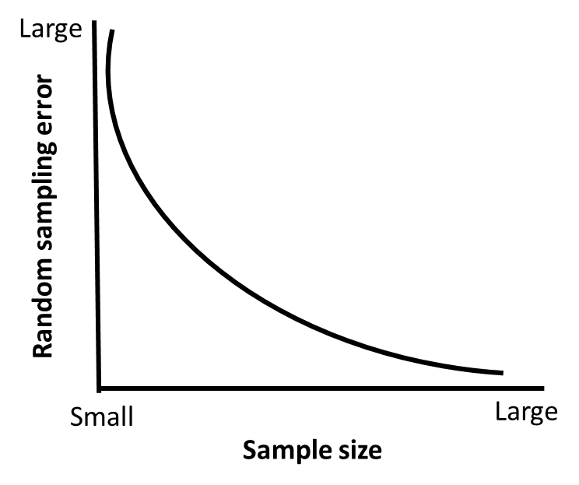
Determine appropriate sample size
The sample size is an important feature of any empirical study in which the goal is to make inferences about a population from a sample. The sample size used in a study is usually determined based on the cost, time, or convenience of collecting the data, and the need for it to offer sufficient statistical power.
If sample size is too small: These skew the results and don’t get a fair picture of the whole population.
If the sample size is too big: the whole study becomes complex, expensive and time-consuming to run.
Relationship between
sample size and error

Slide 15
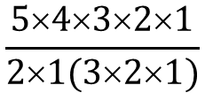
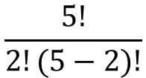

Determine appropriate sample size
Example 1. A population has 5 units (3, 5, 7, 9, 11) from which a sample of 2 units is selected. determine sample size (a) with replacement and (2) without replacement.
Population = (3, 5, 7, 9, 11), population size = 5, sample size n = 2
On the basis of replacement, sample size = N^{n} = 5² = 25
Without replacement, sample size = N_{Cn}
= 5_{C2} =
$$\frac{5!}{2!(5−2)!}$$
$$\frac{54321}{21(321)}$$
$$\frac{120}{12}$$
=
=
=
10

Slide 16
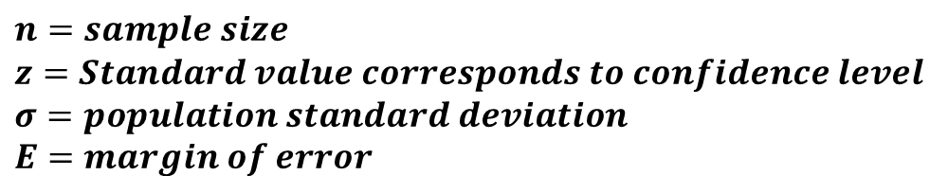

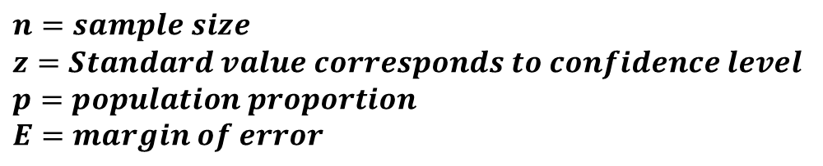

Determine appropriate sample size
sample size for population mean and proportion
1. sample size for estimating population mean :
$$n=\left(\frac{zσ}{E}\right)2$$
$$n=sample size$$
$$z=Standard value corresponds to confidence level$$
$$σ=population standard deviation$$
$$E=margin of error$$
2. Sample size for population Proportion :
$$n=p(1−p)\left(\frac{z}{E}\right)2$$
$$n=sample size$$
$$z=Standard value corresponds to confidence level$$
$$p=population proportion$$
$$E=margin of error$$

Slide 17
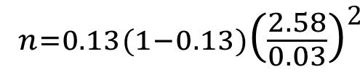


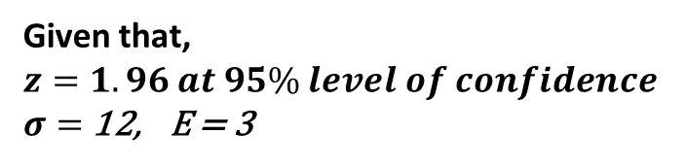
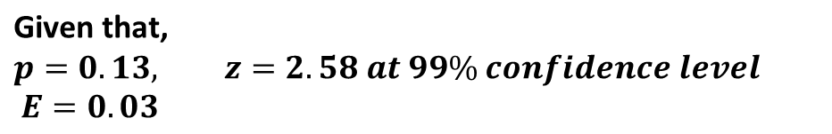



Determine appropriate sample size
sample size for population mean and proportion
Example 2. A population is estimated to have a standard deviation of 12. To estimate the population mean within allowable error 3, with 95% level of confidence, how large a sample is required?
Example 3. ACI company wishes to estimate the true proportion of defectiveness of its products at 99% confidence level and with 3% precision rate. Past record indicates 13% of the products are defective. What would be the required sample size for estimating the true proportion of defectiveness in a production lot of 8000 units?
Given that,
$$z=1.96 at 95\% level of confidence$$
$σ=$ 12, E = 3
$$\text{Given} \text{that}\text{, }$$
$$p=0.13, z=2.58 at 99\% confidence level$$
$$E=0.03$$
$$n=\left(\frac{zσ}{E}\right)2$$
$$n= p(1−p)\left(\frac{z}{E}\right)2$$
$$n=\left(\frac{1.96 ×12}{3}\right)2$$
$$n=0.13(1−0.13)\left(\frac{2.58}{0.03}\right)2$$
$$n=61$$
$n=$836

Slide 18
Brief Questions
What is sample?
What is population?
What is sampling frame ?
What is random sampling error?
What is convenience sampling?
What is purposive sampling?
What is quota sampling?
What is stratified sampling?
What is cluster sampling?
What is snowball sampling?

Slide 19
Short Questions
1. Describe sampling design process.
2. Distinguish between probability and non-probability sampling.
3. Distinguish between cluster and stratified sampling.
4. Describe the types of probability sampling.
5. What is sample size? Why sample size is important?

Slide 20

Thank you all

