Slide 1



Slide 2

Class for
BBA 4th year students of Accounting Department

Slide 3

Course Title: Research Methodology
Chapter 6: Data analysis and presentation- univariate statistical analysis
Presented by
BBA 4th year, Accounting
Topic: Test of Hypothesis: t- test
Mushfique Ahmed
Professor, Dept. of Accounting
Ananda Mohan College
Email: musfique64@gmail.com

Slide 4
Learning Objectives :
➢explain the concepts hypothesis testing
Explain the steps of hypothesis test
Describe one tailed and two tailed test
Justify the hypothesis by using’ t’ test
Research Methodology
Test of Hypothesis – t test

Slide 5
Hypothesis
Hypothesis is a statement about a population parameter subject to verification.
Hypothesis test is a procedure based on sample evidence and probability theory whether statement is true or false.

Slide 6
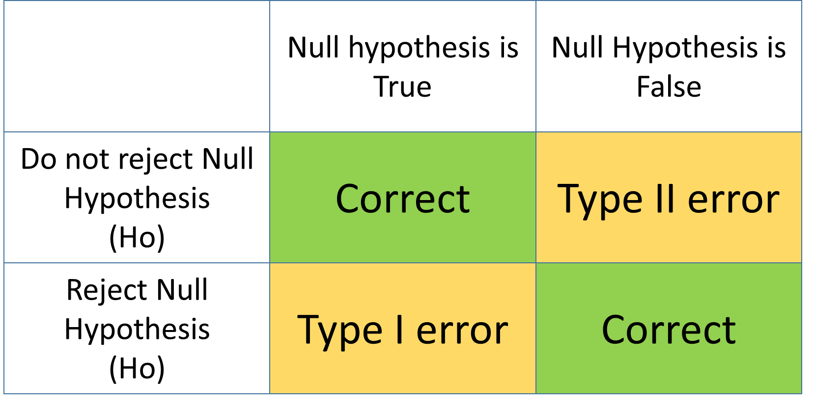
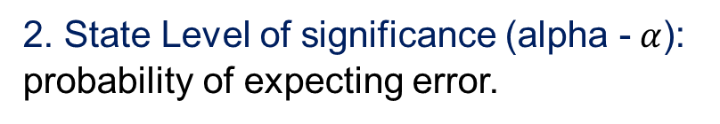
Steps to Hypothesis Test
1. Define null and alternative hypothesis
H₀: μ = μ₀ H₁: μ ≠ μ₀
Where, μ₀ is the comparator or null value
3. State decision rule : If calculated value is greater than the tabulated value, reject the null hypothesis otherwise accept.
4.Test Statistic : Mean Test (Z-test or T-test)
Null hypothesis (H₀)
  The null hypothesis states that a population parameter (such as the mean, the standard deviation, and so on) is equal to a hypothesized value. It is hypothesis of no difference between two outcome variables.
2. State Level of significance (alpha - $α$): probability of expecting error.
5. State result : Reject H₀ or accept H₀ significantly affect the situation or not.
1% | 5% | 10%
0.01 | 0.05 | 0.10
Type I error : Probability of rejecting the null hypothesis (H₀), when it is true
Type II error: Probability of accepting the null hypothesis (H₀) when it is false.
Alternative Hypothesis (H₁)
The alternative hypothesis states that a population parameter is smaller, greater, or different than the hypothesized value in the null hypothesis. There is difference between the two variables.

Slide 7
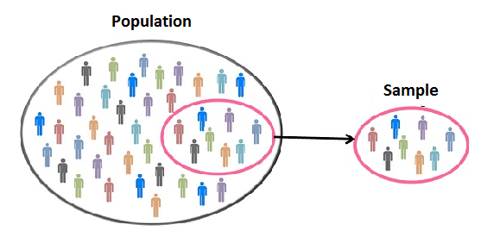
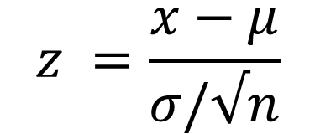

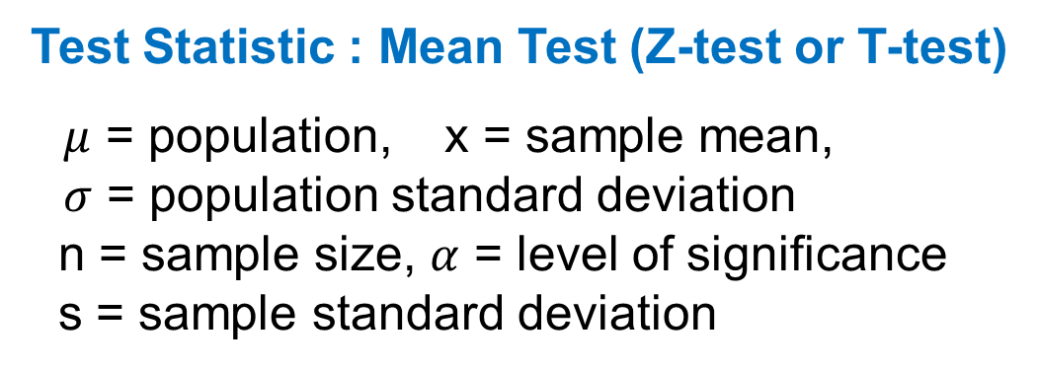


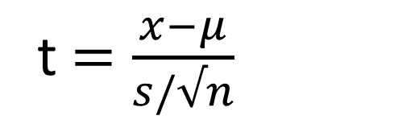
Test Statistic : Mean Test (Z-test or T-test)
$μ$ = population, x = sample mean,
$σ$ = population standard deviation
n = sample size, $α$ = level of significance
s = sample standard deviation
Selection of Z-test or T-test
Test statistic$=\frac{relevant statistic − hypothesied parameter}{standard error of relevant statistic}$
Population standard deviation $(σ$)
$$z =\frac{x−μ}{σ/√n}$$
Given
Not Given
Z test
Sample size (n)
t$=\frac{x−μ}{s/√n}$
$$>30$$
$$<30$$
Z test
T test

Slide 8
One-tailed and Two tailed test
Example question #1: A government official claims that the dropout rate for local schools is 25%. Last year, 190 out of 603 students dropped out. Is there enough evidence to reject the government official’s claim?
Example question #2: A government official claims that the dropout rate for local schools is less than 25%. Last year, 190 out of 603 students dropped out. Is there enough evidence to reject the government official’s claim?
Example question #3: A government official claims that the dropout rate for local schools is greater than 25%. Last year, 190 out of 603 students dropped out. Is there enough evidence to reject the government official’s claim?
In example question #1, Drop out rate = 25%
two-tailed test
In example question #2, Drop out rate < 25%
one-tailed test
In example question #3, Drop out rate > 25%

Slide 9
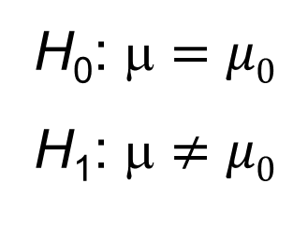
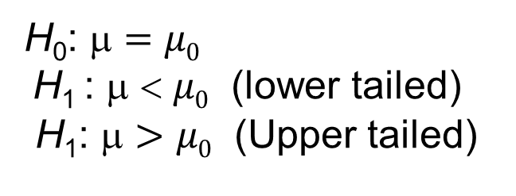
One-tailed alternative hypothesis
  Use a one-sided alternative hypothesis (also known as a directional hypothesis) to determine whether the population parameter differs from the hypothesized value in a specific direction. One-sided test cannot detect whether the population parameter differs in the opposite direction.
Two-tailed alternative hypothesis
  Use a two-sided alternative hypothesis (also known as a non-directional hypothesis) to determine whether the population parameter is either greater than or less than the hypothesized value. A two-sided test can detect when the population parameter differs in either direction.
One tailed test
Two tailed test
H₀: μ $=$ $μ0$
H₁ : μ < $μ0$ (lower tailed)
H₁: μ $>$ $μ0$ (Upper tailed)
H₀: μ $=$ $μ0$
H₁: μ $≠$ $μ0$

Slide 10
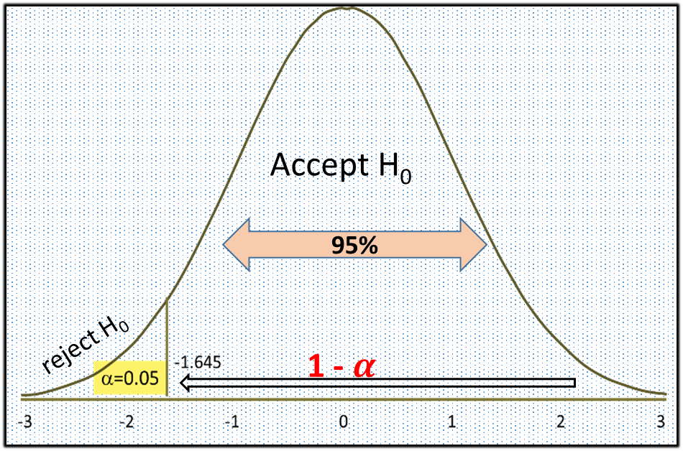
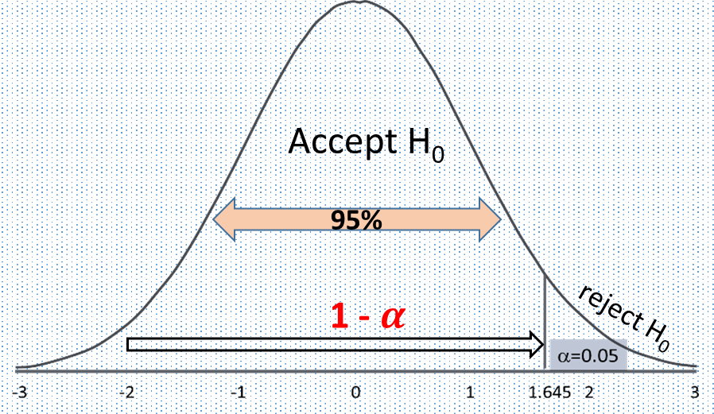
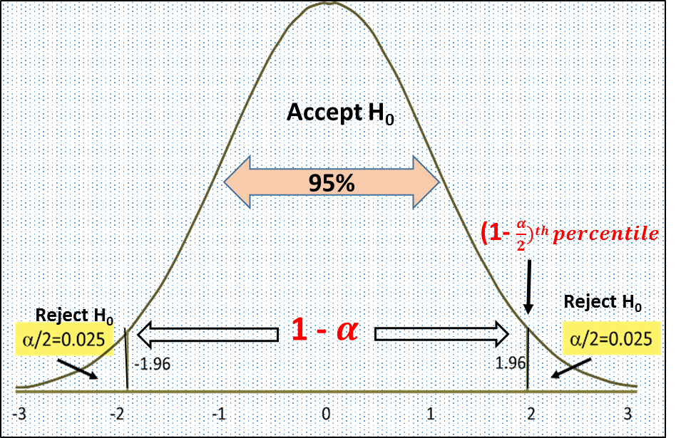
One tailed test – lower tailed
One tailed test – upper tailed
Two tailed test

Slide 11
t - test
(A) t- test of population one sample mean
(B) t-test for difference between two population sample mean

Slide 12
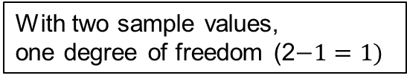
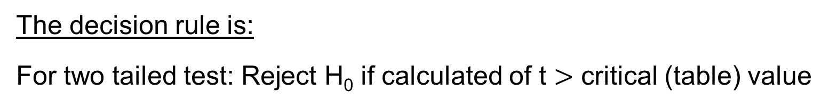
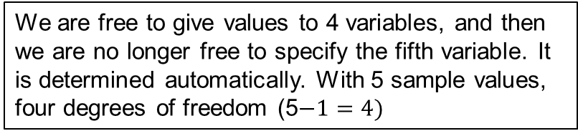
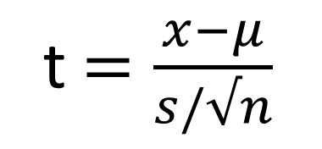


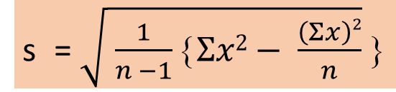
t-test of the population
one sample mean
Degree of freedom : Number of values we can choose freely
The formula for calculating t- score :
$$\frac{a+b+c+d+e}{5}=16$$
t$=\frac{x−μ}{s/√n}$
with d.f. = n− 1, when the value
of s is given and n< 30
We are free to give values to 4 variables, and then we are no longer free to specify the fifth variable. It is determined automatically. With 5 sample values, four degrees of freedom (5$−1=4)$
s = $\sqrt{ \frac{1}{n −1}Σx2− \frac{\left(Σx\right)2}{n}}$
$$\frac{a+b}{2}=18$$
With two sample values,
one degree of freedom (2$−1=1)$
The decision rule is:
For two tailed test: Reject H₀ if calculated of t $>$ critical (table) value

Slide 13
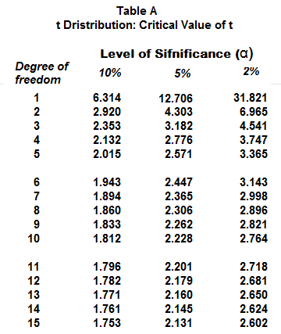

Slide 14
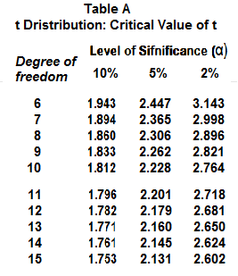
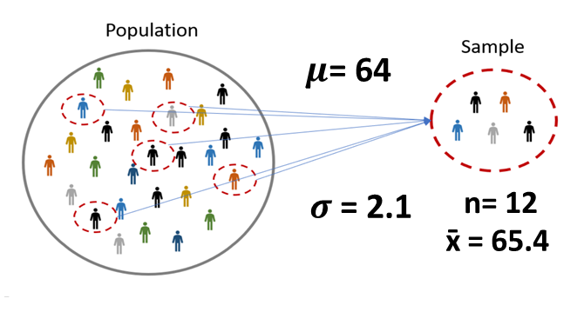
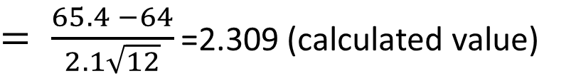
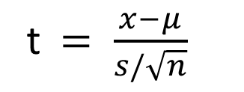
Problem 1: one sample mean
Mean weight and standard deviation of a random sample of 12 students are 65.4 kg and 2.1 kg respectively in a college. Do the data support the hypothesis that the mean weight of all students in the college is 64 kg?
Step 1. Set up hypotheses : H₀: μ = 64 H₁: μ ≠ 64
Step 2. determine level of significance: α = 0.05
Step 3. Set up decision rule.
H₁: μ ≠ 64, with a t- test statistic and selected α = 0.05
with d.f. = n − 1, Reject H₀ if t > 2.201.
Step 4. Test statistic (n < 30):
t$= \frac{x−μ}{s/\sqrt{n}}$
$= \frac{65.4 −64}{2.1\sqrt{12}}$ =2.309 (calculated value)
Step 5. Result and Conclusion: Critical value of t with d.f. 11 at α = 0.05 level of significance is 2.201. The calculated value of t is greater than critical value . So null hypothesis is rejected.

Slide 15
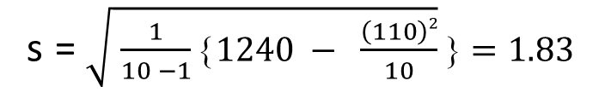
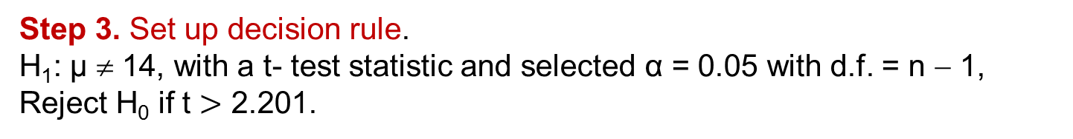

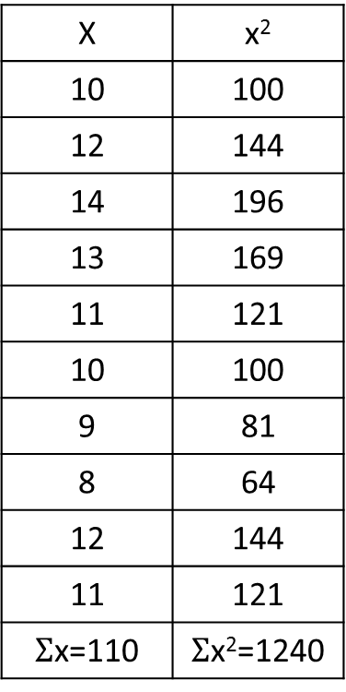
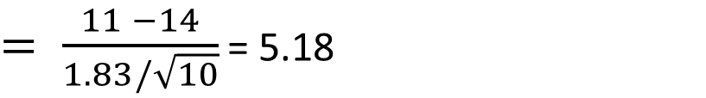
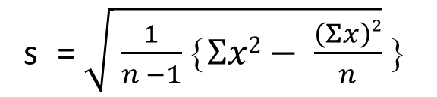
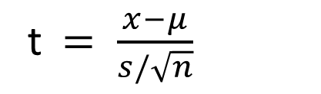
Problem 2: one sample mean
X | x²
10 | 100
12 | 144
14 | 196
13 | 169
11 | 121
10 | 100
9 | 81
8 | 64
12 | 144
11 | 121
$Σ$x=110 | $Σ$x²=1240
A sample of 10 students of BBA 3rd year indicated that the marks obtained by them are as follows: 10, 12, 14, 13, 11, 10, 9, 8, 12, 11. To whether the mean mark obtained by all the students is 14.
Step 1. Set up hypotheses : H₀: μ = 14 H₁: μ ≠ 14
Step 2. determine level of significance: α = 0.05
Step 3. Set up decision rule.
H₁: μ ≠ 14, with a t- test statistic and selected α = 0.05 with d.f. = n − 1, Reject H₀ if t $>$ 2.201.
$x$ = $\frac{110}{10}=11$
Step 4. Test statistic (n < 30):
t$= \frac{x−μ}{s/\sqrt{n}}$
d.f. = 10 − 1=9
s = $\sqrt{ \frac{1}{n −1}Σx2− \frac{\left(Σx\right)2}{n}}$
$= \frac{11 −14}{1.83/\sqrt{10}}$ = 5.18
s = $\sqrt{ \frac{1}{10 −1}1240 − \frac{\left(110\right)2}{10}}=1.83$
Step 5. Result and Conclusion: Critical value of t with d.f. 9 at α = 0.05 level of significance is 2.262. The calculated value of t is greater than critical value . So null hypothesis is rejected.

Slide 16


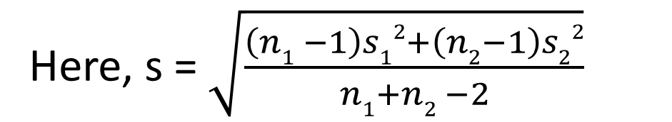
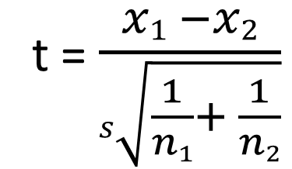
(B) t- test for difference between two sample mean
When sample variance ( s$12$ and s$22$ ) are given and sample size is less than 30. (n₁<30 and n₂<30):
‾x₁ = mean of
1st sample
‾X₂ = Mean of
2nd sample
t = $\frac{x1 −x2}{s\sqrt{\frac{1}{n1}+ \frac{1}{n2}}}$
With d.f. = n₁ + n₂ − 2
Here, s = $\sqrt{\frac{\left(n1 −1\right)s12+\left(n2−1\right)s22}{n1+n2 −2}}$
decision rule : If calculated value if less than table value then null hypothesis is accepted

Slide 17
Problem 3
A social investigation committee is conducting an investigation in comparable jobs between male and female worker. Male and female workers are paid identical wages and following information are given:
 | Men | women
Number of workers | 8 | 7
Mean salary | 1234 | 1036
Standard salary | Tk. 36 | Tk. 40
Test the significant difference between mean salaries of male and female.

Slide 18
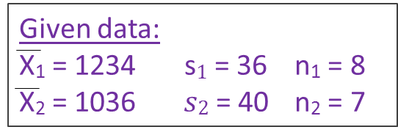
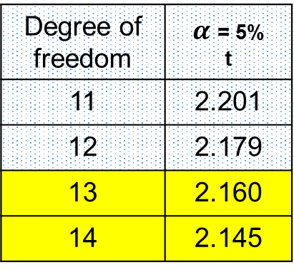
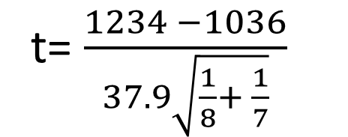
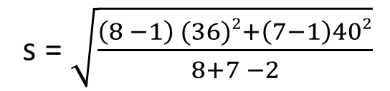
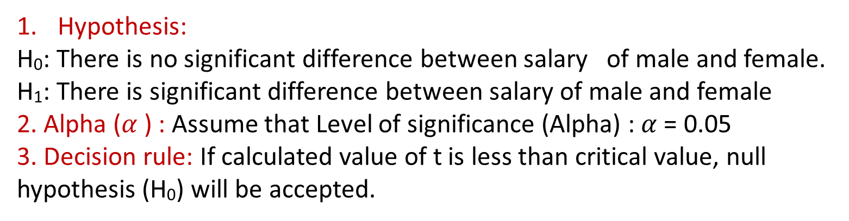
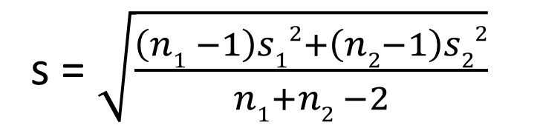

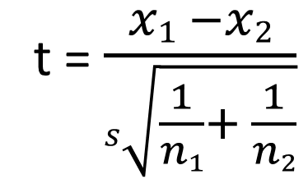
Problem 3: solution
Degree of freedom | $α$ = 5% t
11 | 2.201
12 | 2.179
13 | 2.160
14 | 2.145
Hypothesis:
H₀: There is no significant difference between salary of male and female.
H₁: There is significant difference between salary of male and female
2. Alpha ($α$) : Assume that Level of significance (Alpha) : $α$ = 0.05
3. Decision rule: If calculated value of t is less than critical value, null hypothesis (H₀) will be accepted.
t = $\frac{x1 −x2}{s\sqrt{\frac{1}{n1}+ \frac{1}{n2}}}$
4. Test statistic:
s = $\sqrt{\frac{\left(n1 −1\right)s12+\left(n2−1\right)s22}{n1+n2 −2}}$
t= $\frac{1234 −1036}{37.9\sqrt{\frac{1}{8}+ \frac{1}{7}}}$
= 10.09
s = $\sqrt{\frac{\left(8 −1\right) (36)2+\left(7−1\right)402}{8+7 −2}}$
$$=37.9$$
5. Result and conclusion: Since the calculated value of t =10.09 is greater than critical value of t = 2.160 at 5% level of significance with d.f. 13, therefore null hypothesis (H₀) is rejected.

Slide 19
Problem 4
You are given the following data about the expected life of two brand of energy bulbs:
 | Mean life | Standard deviation | Sample size
Brand A | 2000 hours | 250 hours | 12
Brand b | 2230 hours | 300 hours | 15
Do you think there is a significant difference in the quality of the two brands of energy bulbs?

Slide 20


Thank you all
Stay Home

