Slide 1



Class for
BBA 4th year students
of
Accounting Department

Slide 2

Research Methodology
Chapter 6: Data analysis and presentation- univariate statistical analysis
BBA 4th year, Accounting
Presented by
Test of Hypothesis
Mushfique Ahmed
Professor, Dept. of Accounting
Ananda Mohan College
Email: musfique64@gmail.com

Slide 3
Hypothesis
Hypothesis is a statement about a population parameter subject to verification.
Hypothesis test is a procedure based on sample evidence and probability theory whether statement is true or false.

Slide 4
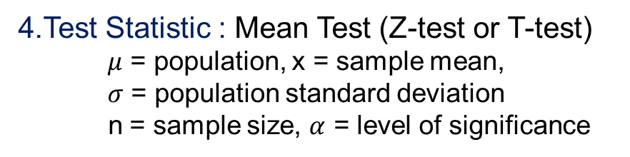
Steps to Hypothesis Test
1. Define null and alternative hypothesis
H₀: μ = μ₀ H₁: μ ≠ μ₀
where μ₀ is the comparator or null value
3. State decision rule : If calculated value (Z) lies between the tabulated value, accept the null hypothesis otherwise reject.
Null hypothesis (H₀)
  The null hypothesis states that a population parameter (such as the mean, the standard deviation, and so on) is equal to a hypothesized value.
2. State Level of significance (alpha): probability of expecting error.
4.Test Statistic : Mean Test (Z-test or T-test)
$μ$ = population, x = sample mean,
$σ$ = population standard deviation
n = sample size, $α$ = level of significance
1% | 5% | 10%
0.01 | 0.05 | 0.10
Type I error : Probability of rejecting the null hypothesis (H₀), when it is true
Type II error: Probability of accepting the null hypothesis (H₀) when it is false.
5. State result : Reject H₀ or accept H₀ significantly affect the situation or not.
Alternative Hypothesis (H₁)
The alternative hypothesis states that a population parameter is smaller, greater, or different than the hypothesized value in the null hypothesis.

Slide 5
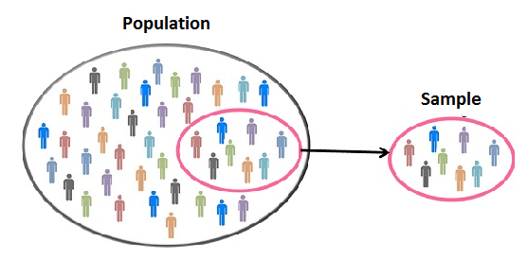
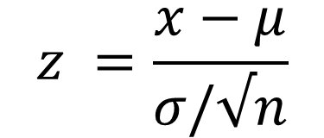
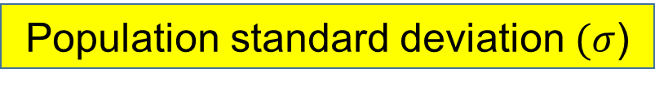
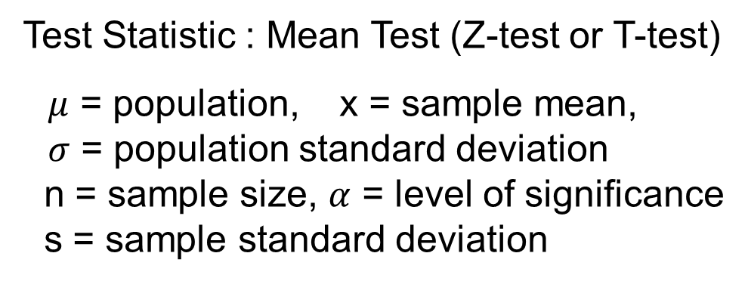


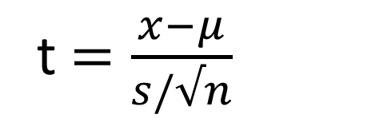
Test Statistic : Mean Test (Z-test or T-test)
$μ$ = population, x = sample mean,
$σ$ = population standard deviation
n = sample size, $α$ = level of significance
s = sample standard deviation
Test statistic$=\frac{relevant statistic − hypothesied parameter}{standard error of relevant statistic}$
Population standard deviation $(σ$)
$$z =\frac{x−μ}{σ/√n}$$
Standard error
Given
Not Given
Z test
Sample size (n)
t$=\frac{x−μ}{s/√n}$
Estimated
Standard error
$$>30$$
$$<30$$
Z test
T test

Slide 6
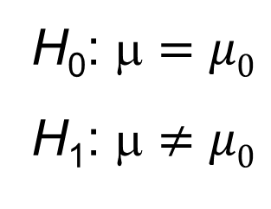
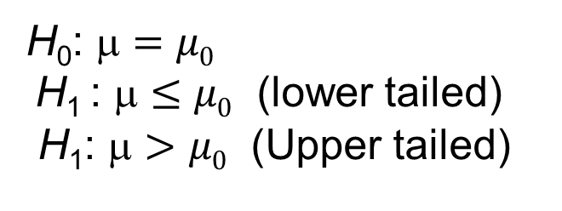
One-tailed alternative hypothesis
  Use a one-sided alternative hypothesis (also known as a directional hypothesis) to determine whether the population parameter differs from the hypothesized value in a specific direction. One-sided test cannot detect whether the population parameter differs in the opposite direction.
Two-tailed alternative hypothesis
  Use a two-sided alternative hypothesis (also known as a non-directional hypothesis) to determine whether the population parameter is either greater than or less than the hypothesized value. A two-sided test can detect when the population parameter differs in either direction.
One tailed test
Two tailed test
H₀: μ $=$ $μ0$
H₁ : μ $≤$ $μ0$ (lower tailed)
H₁: μ $>$ $μ0$ (Upper tailed)
H₀: μ $=$ $μ0$
H₁: μ $≠$ $μ0$

Slide 7
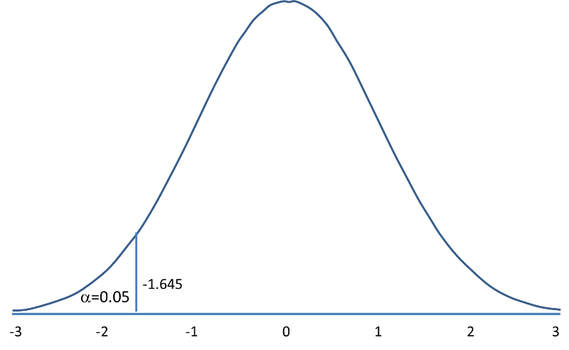
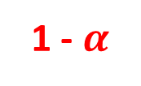

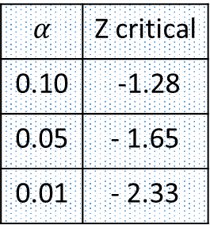
One tailed test – lower tailed
Accept H₀
$$α$$
95%
$$α$$ | Z critical
0.10 | -1.28
0.05 | - 1.65
0.01 | - 2.33
reject H₀
1 - $α$
Rejection Region for Lower-Tailed Z Test
(H₁: μ < μ₀ ) with α =0.05
The decision rule is: Reject H₀ if Z < 1.65

Slide 8
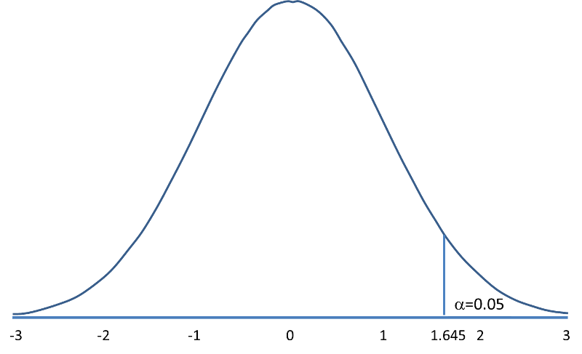
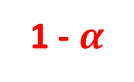

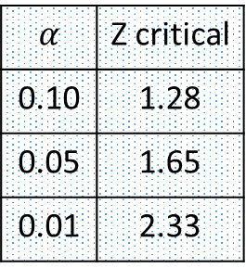
One tailed test – upper tailed
$$α$$
Accept H₀
$$α$$ | Z critical
0.10 | 1.28
0.05 | 1.65
0.01 | 2.33
95%
1 - $α$
reject H₀
Rejection Region for Upper-Tailed Z Test (H₁: μ > μ₀ ) with α=0.05
The decision rule is: Reject H₀ if Z > 1.645

Slide 9
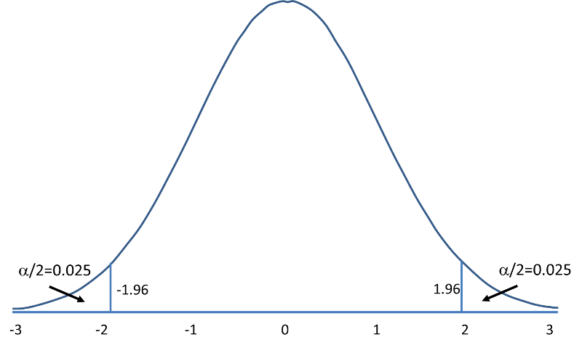



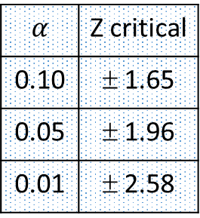

Two tailed test
Accept H₀
$$α/2$$
$$α/2$$
95%
$$α$$ | Z critical
0.10 | ± 1.65
0.05 | ± 1.96
0.01 | ± 2.58
(1- $\frac{α}{2})th percentile$
Reject H₀
Reject H₀
1 - $α$
Rejection Region for Two-Tailed Z Test
(H₁: μ ≠ μ ₀ ) with α =0.05
The decision rule is: Reject H₀ if Z < -1.96 or if Z > 1.96

Slide 10
Z - test
(A) Z- test for one sample mean
(B) Z-test for two sample mean
(C) Z-test for two population proportion

Slide 11
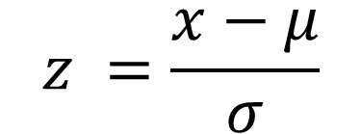
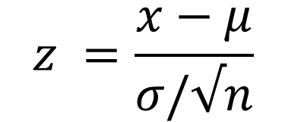
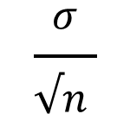

(A) z-test for one sample mean
The formula for calculating z score -
$$\frac{σ}{√n }$$
$$z =\frac{x−μ}{σ}$$
$$Standard error=$$
$$z =\frac{x−μ}{σ/√n}$$
The decision rule is:
For lower tailed test: Reject H₀ if z < critical value
For upper tailed test: Reject H₀ if z > critical value
For two tailed test: Reject H0 if Z < critical value or if Z > critical value

Slide 12
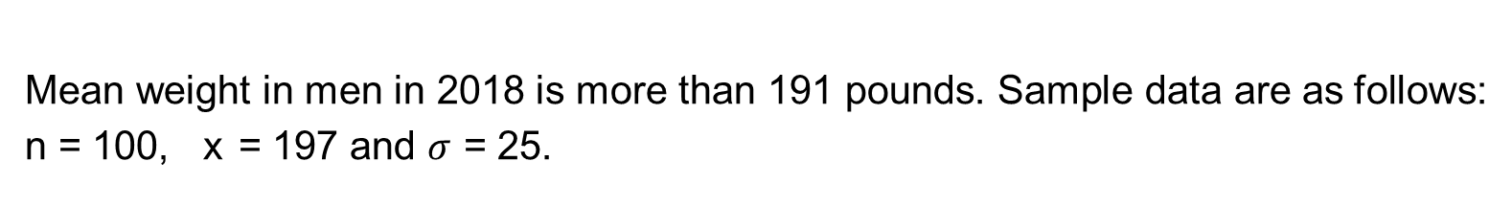
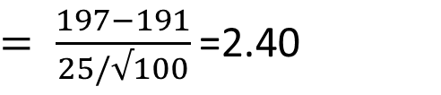
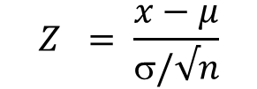
Problem 1: one sample mean
Mean weight in men in 2018 is more than 191 pounds. Sample data are as follows: n = 100, x = 197 and $σ$ = 25.
Step 1. Set up hypotheses : H₀: μ = 191 H₁: μ > 191
Step 2. determine level of significance: α =0.05
Step 3. Set up decision rule.
upper tailed test (H₁: μ >191), with a Z test statistic and selected α = 0.05
Reject H₀ if Z > 1.645.
Step 4. Test statistic (n>30):
$$Z = \frac{x−μ}{σ/√n}$$
$= \frac{197−191}{25/√100}$ =2.40
Step 5. Result and Conclusion: z = 2.40, reject H₀ because 2.40 > 1.65

Slide 13
P-value
We reject H₀ because 2.40 > 1.65. We have statistically significant evidence at a = 0.05, to show that the mean weight in men in 2018 is more than 191 pounds. Because we rejected the null hypothesis,
we now approximate the p-value which is the likelihood of observing the sample data if the null hypothesis is true. An alternative definition of the p-value is the smallest level of significance where we can still reject H₀

Slide 14
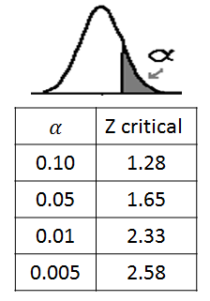
P-value
Using the table of critical values for upper tailed tests, we can approximate the p-value. If we select α=0.025, the critical value is 1.96, and we still reject H₀ because 2.40 > 1.96.
If we select α = 0.01 the critical value is 2.33, and we still reject H₀ because 2.40 > 2.33.
However, if we select α=0.005, the critical value is 2.58, and we cannot reject H₀ because 2.40 < 2.58. Therefore, the smallest α where we still reject H₀ is 0.010. This is the p-value.
A statistical computing package would produce a more precise p-value which would be in between 0.005 and 0.010. Here we are approximating the p-value and would report p < 0.010.

Slide 15
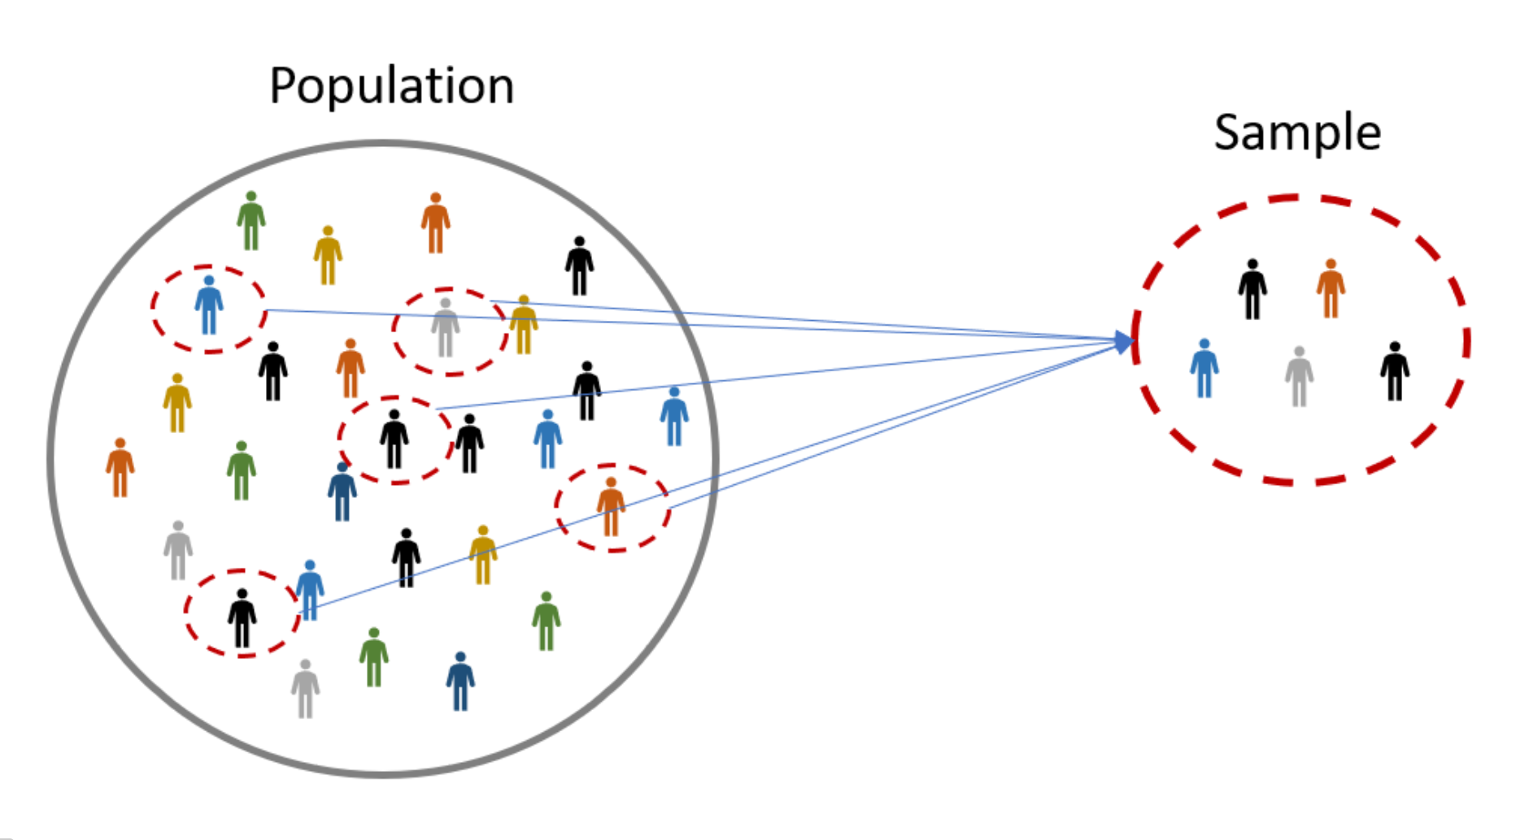



Problem 2: one sample mean
In the population, the average IQ is 100 with a standard deviation of 15.
A team of scientists wants to test new medication to see if it has either a positive or negative effect on intelligence or no effect at all. A sample of 30 participants who have taken the medication has a mean of 140. Did the medication affect intelligence?
$μ$= 100
n= 30
$\text{x}\text{̄ }$= 140
$σ$= 15

Slide 16
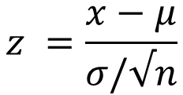
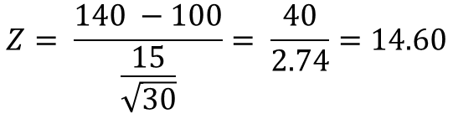
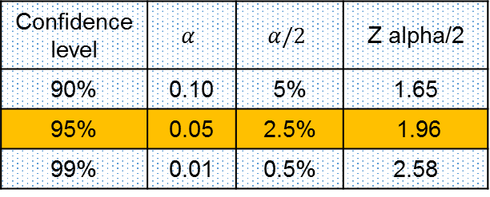
1. Define Null and Alternative Hypothesis
H₀: μ = 100
H₁: μ ≠ 100
4. Calculate Test statistics
formula for calculating z score for a sample mean:
$$z =\frac{x−μ}{σ/√n}$$
2. State level of significance (Alpha)
α = 0.05
$$Z= \frac{140 −100}{\frac{15}{\sqrt{30}}}= \frac{40}{2.74}=14.60$$
3. State decision rule
5. State result
Z is greater than 1.96, so reject the null hypothesis (H₀). Medication significantly affected intelligence, Z = 14.60, p < 0.05
95%
2.5%
2.5%
115
130
Confidence level | $$α$$ | $$α/2$$ | Z alpha/2
90% | 0.10 | 5% | 1.65
95% | 0.05 | 2.5% | 1.96
99% | 0.01 | 0.5% | 2.58
70
85
100
μ
If Z is less than -1.96, or greater than
1.96, reject the null hypothesis

Slide 17
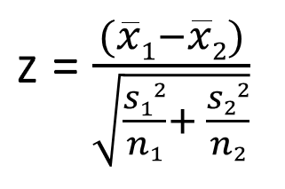
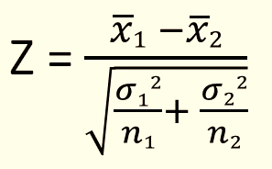
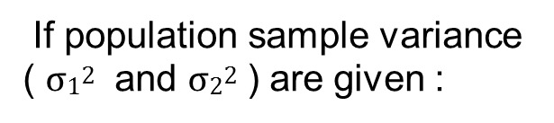

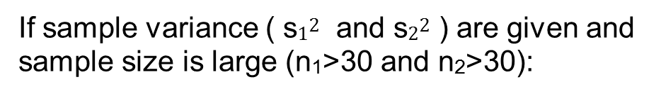
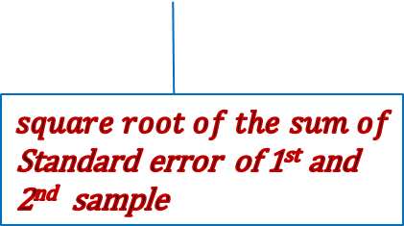
(B) z- test for two sample mean
If sample variance ( s$12$ and s$22$ ) are given and sample size is large (n₁>30 and n₂>30):
‾x₁ = mean of
1st sample
‾X₂ = Mean of
2nd sample
If population sample variance ( $σ12$ and $σ22$ ) are given :
$square root of the sum of$Standard error of 1st and 2nd sample

Slide 18
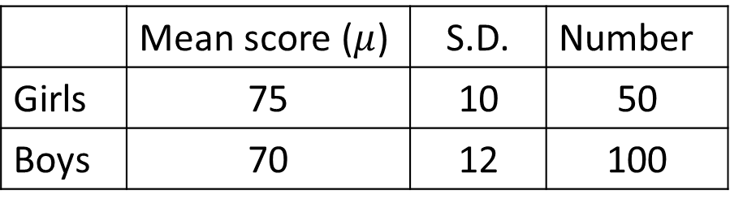
Problem 3
Intelligence test given to two groups of boys and girls gave the following information:
Is the difference in the mean scores of boys and girls statistically significant?
 | Mean score ($μ$) | S.D. | Number
Girls | 75 | 10 | 50
Boys | 70 | 12 | 100

Slide 19
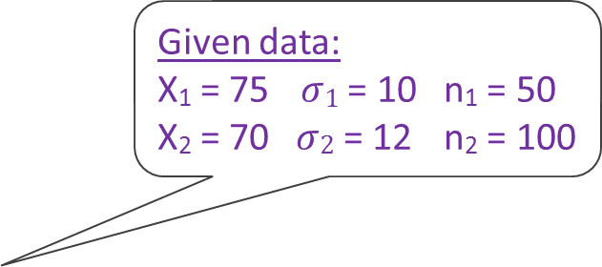
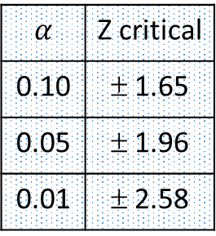
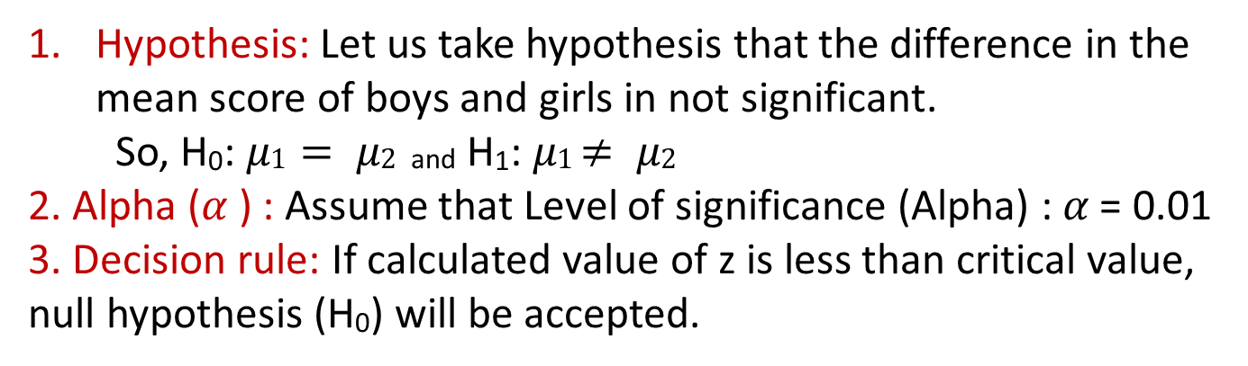
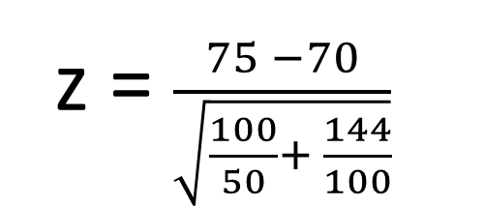
Problem 3: solution
Hypothesis: Let us take hypothesis that the difference in the mean score of boys and girls in not significant.
So, H₀: $μ1= μ2$ and H₁: $μ1$ $≠ μ2$
2. Alpha ($α$) : Assume that Level of significance (Alpha) : $α$ = 0.01
3. Decision rule: If calculated value of z is less than critical value, null hypothesis (H₀) will be accepted.
Given data:
X₁ = 75 $σ1$ = 10 n₁ = 50 X₂ = 70 $σ2$ = 12 n₂ = 100
4. Test statistic:
$$α$$ | Z critical
0.10 | ± 1.65
0.05 | ± 1.96
0.01 | ± 2.58
z = $\frac{75 −70}{\sqrt{\frac{100}{50}+ \frac{144}{100}}}$
= 2.695
5. Result and conclusion: Since the calculated value of z = 2.695 is greater than critical value of z = 2.58 at 1% level of significance, therefore null hypothesis (H₀) is rejected.

Slide 20
Problem 4
Test the difference between two sample mean for the following data:
 | 1st sample | 2nd sample
Average monthly income (Tk.) | 15000 | 13000
Standard deviation (Tk.) | 600 | 700
Sample size | 60 | 75

Slide 21
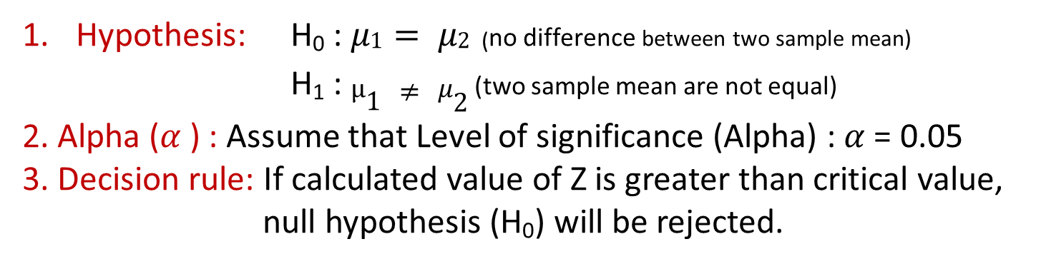
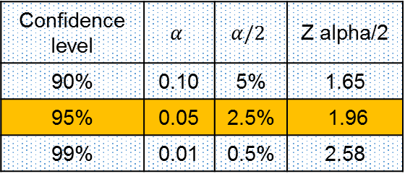
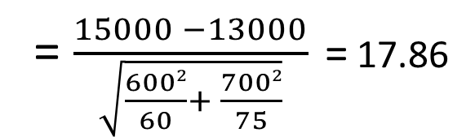
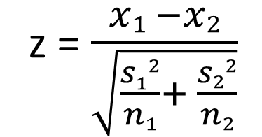
Problem 4 : solution
Hypothesis: H₀ : $μ1= μ2$ (no difference between two sample mean)
H₁ : $μ1 ≠ μ2$(two sample mean are not equal)
2. Alpha ($α$) : Assume that Level of significance (Alpha) : $α$ = 0.05
3. Decision rule: If calculated value of Z is greater than critical value,
null hypothesis (H₀) will be rejected.
4. Test statistic: Hence sample variance ( s$12$ and s$22$ ) are given and sample size is large (n₁>30 and n₂>30), then
Confidence level | $$α$$ | $$α/2$$ | Z alpha/2
90% | 0.10 | 5% | 1.65
95% | 0.05 | 2.5% | 1.96
99% | 0.01 | 0.5% | 2.58
z = $\frac{x1 −x2}{\sqrt{\frac{s12}{n1}+ \frac{s22}{n2}}}$
 | 1st sample | 2nd sample
Average income | 15000 | 13000
Standard deviation | 600 | 700
Sample size | 60 | 75
= $\frac{15000 −13000}{\sqrt{\frac{6002}{60}+ \frac{7002}{75}}}$ = 17.86
5. Result and conclusion: Since the calculated value of z = 17.86 is greater than critical value of z = 1.96 at 5% level of significance, therefore null hypothesis (H₀) is rejected. So there is a significant difference between two sample mean.

Slide 22
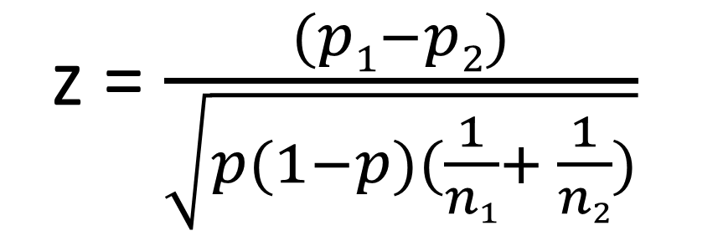
(C) Z- test for two population proportion
z = $\frac{(p1−p2)}{\sqrt{p(1−p)(\frac{1}{n1}+ \frac{1}{n2})}}$
        P₁ = 1st population proportion
        P₂ = 2nd population proportion
        n₁ = 1st sample size
        n₂ = 2nd sample size
        P = Overall proportion = (n₁+n₂)/(p₁+p₂)
Problem 5:
You are testing two flu drugs A and B . Drug A works on 351 people in a population of 605 . Drug B works on 41 people out of 195 people. Are the two drug comparable? Use a 5% alpha level.

Slide 23
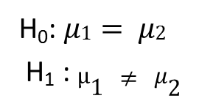
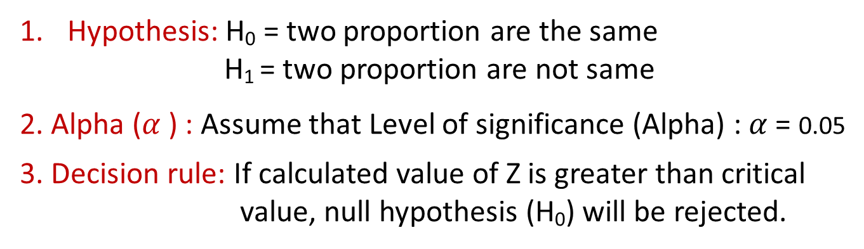
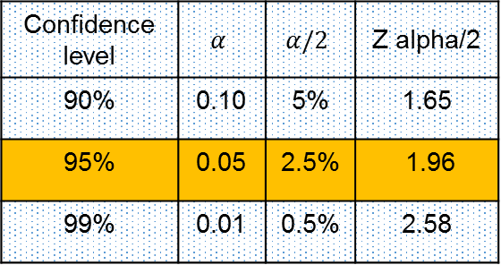
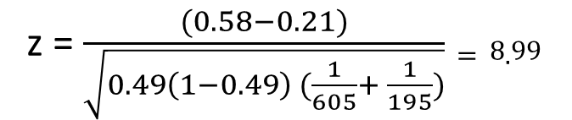
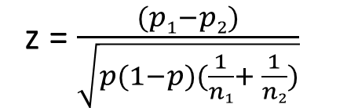
Z- test for two population proportion
Hypothesis: H₀ = two proportion are the same
        H₁ = two proportion are not same
        2. Alpha ($α$) : Assume that Level of significance (Alpha) : $α$ = 0.05
3. Decision rule: If calculated value of Z is greater than critical
value, null hypothesis (H₀) will be rejected.
H₀: $μ1= μ2$
H₁ : $μ1 ≠ μ2$
Confidence level | $$α$$ | $$α/2$$ | Z alpha/2
90% | 0.10 | 5% | 1.65
95% | 0.05 | 2.5% | 1.96
99% | 0.01 | 0.5% | 2.58
4. Test statistic:
z = $\frac{(p1−p2)}{\sqrt{p(1−p)(\frac{1}{n1}+ \frac{1}{n2})}}$
        Drug A = 351/605 = 0.58 or 58%
        Drug B = 41/195 = 0.21 or 21%
        Overall proportion “p” = (41+351)/(195+605) = 0.49
z = $\frac{(0.58−0.21)}{\sqrt{0.49\left(1−0.49\right) (\frac{1}{605}+ \frac{1}{195})}}=8.99$
You are testing two flu drugs A and B . Drug A works on 351 people in a sample of 605. Drug B works on 41 people out of a sample of 195. Are the two drug comparable? Use a 5% alpha level.
5. Result and conclusion: Since the calculated value of z = 8.99 is greater than critical value of z = 1.96 at 5% level of significance, therefore null hypothesis (H₀) is rejected. So there is a significant difference between A and B.

Slide 24

Thank you all

