Slide 1




Class for
BBA 4th year students
of
Accounting Department

Slide 2

Presented by
Research Methodology
Chapter 1:
Theory Building
Mushfique Ahmed
Professor and Head of
Accounting Department
Email: musfique64@gmail.com

Slide 3
Questions
1. What is theory?
2. What are the building block of a theory?
3. What are the benefits of using theories in research?
4. What are the methods of formulating theory?
5. Distinguish between deductive reasoning and inductive reasoning.

Slide 4

1. What is theory?
Theories are explanations of a natural or social behavior, event, or phenomenon (NUbv) .
A theory is a formal, testable explanation of some events that includes explanations of how things relate to one another.
Theory is a generalization about a phenomenon (NUbv) that explain how or why the phenomenon occurs.
Theory is an idea to explain something, or a set of guiding principles.

Slide 5
1. What is theory?
While understanding theories, it is also important to understand what theory is not.
Theory is not data, facts, taxonomies (†kÖYxwem¨vm), or empirical (M‡elYvg~jK) findings.
A collection of constructs (concept or model) is not a theory, because theories must go well beyond constructs to include propositions (wee„wZ), explanations, and boundary conditions.
A collection of facts is not a theory, just as a pile of stones is not a house.
Data, facts, and findings operate at the empirical (cixÿvg~jK) or observational level, while theories operate at a conceptual level and are based on logic rather than observations.

Slide 6



2. Building Blocks of a Theory
constructs
Constructs capture the “what” of theories (i.e., what concepts are important for explaining a phenomenon)
David Whetten (1989) suggests that there are four building blocks of a theory:
1
propositions capture the “how” (i.e., how are these concepts related to each other). Propositions are stated in declarative form and should ideally indicate a cause-effect relationship (e.g., if X occurs, then Y will follow).
2
propositions
logic
logic represents the “why” (i.e., why are these concepts related)
3
boundary
conditions/
assumptions
boundary conditions examine the “who, when, and where” (i.e. under what circumstances will these concepts and relationships work).
4
All theories are constrained (Ave×) by assumptions about values, time, and space, and boundary conditions that govern where the theory can be applied and where it cannot be applied.

Slide 7
3. What are the benefits of using theories in research?
Theories provide the underlying logic of the occurrence of natural or social phenomenon by explaining what are the key drivers and key outcomes of the target phenomenon and why, and what underlying processes are responsible driving that phenomenon.
1
2
Theories provide guidance for future research by helping identify constructs and relationships that are worthy of further research.
Theories can contribute to cumulative knowledge building by bridging gaps between other theories and by causing existing theories to be reevaluated in a new light.
3

Slide 8
4. What are the methods of formulating theory?
Deductive reasoning
2. Inductive reasoning
Deductive reasoning
Deductive reasoning is a top-down approach that drills inward from the general to the specific.
In empirical research, this means a market researcher begins a study by considering theories that have been developed in conjunction with a topic of interest.
Inductive reasoning
Inductive reasoning is a bottom-up approach that moves from the specific to the general.
In this case, the term specifically refers to an observation made by the market researcher that eventually leads to a broad generalization and theory.

Slide 9
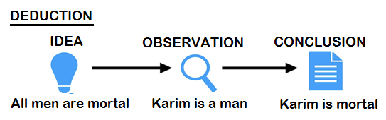
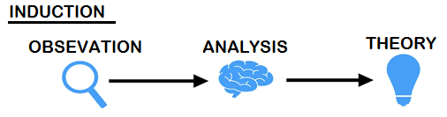
5. Difference between deduction and induction
Inductive Reasoning
Theory
Theory
Deductive reasoning
Tentative
Hypothesis
Hypothesis
Observation
Analysis
Observation
Confirmation

Slide 10
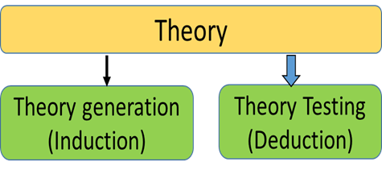
Deductive reasoning and Inductive reasoning
Deductive reasoning, or deduction, is making an inference(Abygvb) based on widely accepted facts or premises.
Inductive reasoning, or induction, is making an inference based on an observation, often of a sample.
The main difference between inductive and deductive reasoning is that inductive reasoning aims at developing a theory while deductive reasoning aims at testing an existing theory.
Deduction moves from idea to observation, while induction moves from observation to idea.
Deduction moves from theory to experiment to validation, where induction moves from observation to generalization to theory.
If the premises are true in deduction, the conclusion is definitely true. If the premises (c~e©vbygvb) are true in induction, the conclusion is only probably true depending on how good the evidence is.
Deduction is more precise and quantitative, while induction is more general and qualitative.

Slide 11
Deductive Research Steps:
General query of literature theories
Define topic of interest
Theory-related Idea
Hypothesis
Data collection
Data analysis and hypothesis testing
Confirmation of the hypothesis
Dissemination of the findings
Inductive Research Steps:
Specific observations and measurements
Topic of interest emerges
Data collection
Data clusters or patterns
Data analysis
Emergence of themes
Generalizations
Dissemination of findings

Slide 12

Thank you all

